Slide 1
What is Working Capital?

Slide 2
Capital is another word for ‘money’ & working capital (WC) is the amount of money that one requires for funding the day-to-day operations of a business.
In financial terms it is the difference between current assets & current liabilities.
WC = Current Assets – Current Liabilities

Slide 3
WC is an indicator of a company’s operating & financial health.
WC Ratio (Current Ratio) = Current Assets/Current Liabilities
It gives an indication as to whether a company has enough short-term assets to meet its short-term debts.

Slide 4
Desirable WC ratio is between 2:1.
In other words, a company has ample cash to meet its short-term obligations but not too much sitting around doing nothing.
A ratio below 1 indicates a negative WC. In other words, the company is struggling to repay its debts.

Slide 5
A ratio above 2 indicates that the company has lot of extra cash which it could have invested in the business to generate maximum possible revenue.

Slide 6
Working Capital Management

Slide 7
WC management or short-term capital management is concerned with decisions relating to current assets & current liabilities.
The financial decisions relates to cash flows within a year or within the operating cycle of the firm.

Slide 8
Two Concepts of WC

Slide 9
There are two concepts of WC:
Gross WC; &
Net WC
Gross WC is the total of all current assets.
The different components of current assets are:

Slide 10
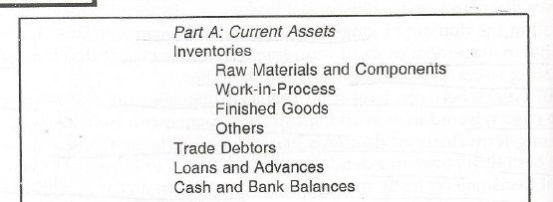
Table 1: Different Components of Current Assets

Slide 11
Net WC refers to the difference between current assets & current liabilities.
The different components of current liabilities are:

Slide 12
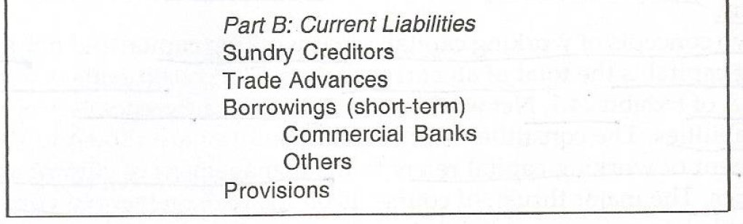
Table 2: Different Components of Current Liabilities

Slide 13
Management of WC refers to the management of current assets as well as current liabilities.
However, major thrust is given upon current assets. This is obvious since current liabilities are paid out of current assets.

Slide 14
Characteristics of Current Assets

Slide 15
In the management of WC two characteristics of current assets are:
Short Life Span; &
Swift transformation in to other asset forms

Slide 16
Short Life Span
Current assets have a short life span.
For e.g., cash balances may be held idle for a week or two; accounts receivables may have a life span of 30 to 60 days; inventories may be held for 30 to 100 days.

Slide 17
The life span of current assets depends upon the time required in the activities of procurement, production, sales & collection & the degree of synchronisation among them.

Slide 18
Swift transformation in to other asset forms
Each current asset is swiftly transformed into other asset forms. This is depicted in the diagram in the next slide.

Slide 19
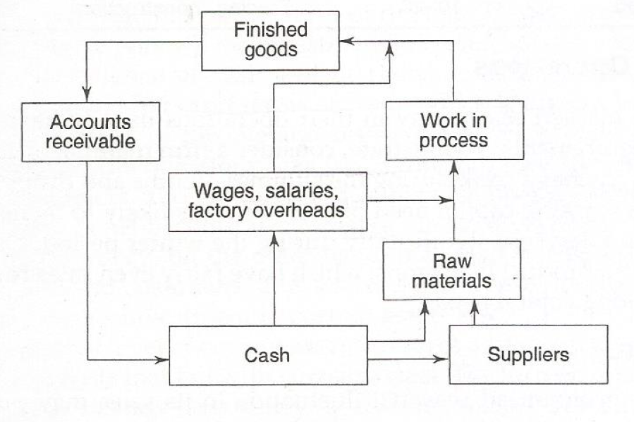
Fig.1: Current Assets Cycle

Slide 20
From the diagram (in the previous slide) it can be inferred that cash is used for acquiring raw materials; raw materials are transformed into finished goods (this transformation may involve several stages of work-in-process); finished goods (generally sold on credit) are converted in to accounts receivable; & finally accounts receivable (on realisation) generates cash.

Slide 21
Factors Influencing Working Capital Requirements

Slide 22
The WC needs of a firm are influenced by different factors. The important ones are:
Nature of business;
Seasonality of operations;
Production policy;
Market conditions; &
Conditions of supply

Slide 23
Nature of Business
The WC requirement of a firm is related to the nature of its business.
For e.g., a service firm (electricity undertaking/ transport corporation) which has a short operating cycle & which sells predominantly on cash basis has a modest WC requirement.

Slide 24
However, a manufacturing concern (machine tools unit) which has a long operating cycle & which sells largely on credit has a substantial WC requirement.
Table in the next slide shows the relative proportions of investment in current assets & fixed assets for different industries.

Slide 25
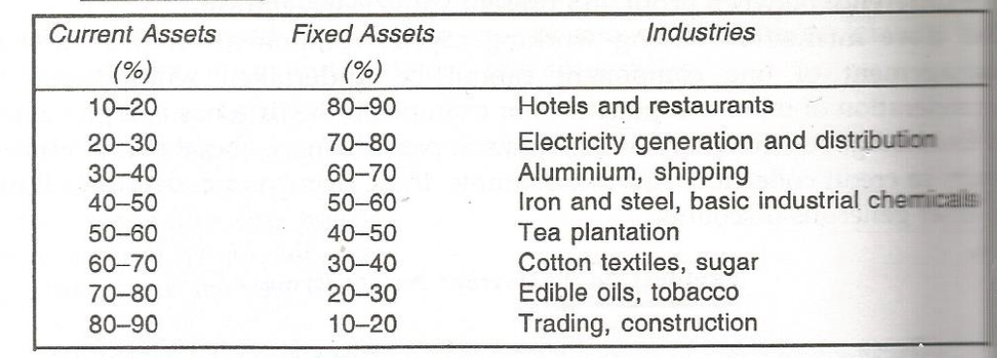
Table 3: Proportion of Current Assets & Fixed Assets

Slide 26
Seasonality of Operations
Firms which have marked seasonality in their operations usually have highly fluctuating WC requirements.
For example, in case of a company selling ceiling fans the sale of ceiling fans reaches peak during summer months & drops sharply during the winter period. The WC requirement of such a

Slide 27
company increases during summer months & decreases considerably during winter months.
Production Policy
Companies which have pronounced seasonal fluctuations in their sales (like the company producing ceiling fans stated above) pursues a production policy in order to reduce the sharp variations in the WC requirements.

Slide 28
For e.g., a company producing ceiling fans may maintain a steady production throughout the year rather than intensify the production during the peak season. Such a policy will help to dampen the fluctuations in WC requirements.
Market Conditions
The degree of competition in the market place has an important bearing on WC needs of a company.

Slide 29
For e.g., when competition is more, a large inventory of finished goods is required to promptly serve customers who may not be ready to wait as other manufacturers may be ready to meet their needs.
Hence, WC needs are high because of greater investments in finished goods inventory & accounts receivable.

Slide 30
If competition is weak a company can manage with a small inventory of finished goods as customers can be served with some delay.
In addition, in such a situation the company can insist on cash payments & avoid lock up of funds in accounts receivable.

Slide 31
Conditions of supply
The inventory of raw materials, spares & stores depends on the conditions of supply.
If the supply is prompt & adequate a company can manage with a small inventory.
However, if the supply is unpredictable & scant

Slide 32
then the company in order to ensure continuity of production will have to acquire stocks as & when available as well as maintain large inventory.
A similar policy will be followed for companies where the raw materials are available seasonally & production is carried out throughout the year.

